Slide 1
Slovakia → Ukraine
Sharing Lessons from Public Finance Management Reforms
Kristina Mikulova
Head of Development Cooperation
Ministry of Finance of the Slovak Republic

Slide 2
Outline
Context: public finance management reforms in Slovakia
Topic of the day: fiscal decentralization
Towards the future: opportunities for knowledge exchange between Slovakia and Ukraine

Slide 3
I. PFM Reform at Home
The “Why”? Motivations
macroeconomic instability
public expenditures oscillating around 50% of GDP until early 2000s
no clear priorities in fiscal policy
government deficit was not fully under control until 2002
public debt accumulated during the 1990s due to loose fiscal policy
interest rates extremely high in the late 1990s due to excessive government spending
sovereign rating low
→→ Political context - - - Slovakia dubbed “black hole in the middle of Europe” and lagging behind peers in the EU integration process

Slide 4
I. PFM Reform at Home
The “How”? Sequencing
I. First generation reform (1998-2002)
ensuring economic stability and setting rules for the operation of the private sector (privatization, business environment)
II. Second generation reform (2002-2006)
budget reform, accounting, tax reform, social assistance, labor market, pension system, judiciary, and advancing in fiscal decentralization
III. Third generation reform (2009- )
raising tax revenues, enhancing tax compliance, increasing progressivity, lowering the high tax wedge for low-income workers

Slide 5
I. PFM Reform at Home
The “So What”? Results
one of the lowest public spending to GDP ratios among the EU countries until crisis hits (35%)
all-time low in public debt levels before the crisis (below 30%)
highest sovereign rating score from among the V4 countries in 2009
inflow of FDI made Slovakia an investor haven in the 2000s, coincided with the decline in the statutory CIT rate from 40% in 1999 to 19% in 2004
brisk growth of GDP and employment
→→ Reputational gain: Slovakia nicknamed Tatra Tiger and named The World Bank’s Top Reformer

Slide 6
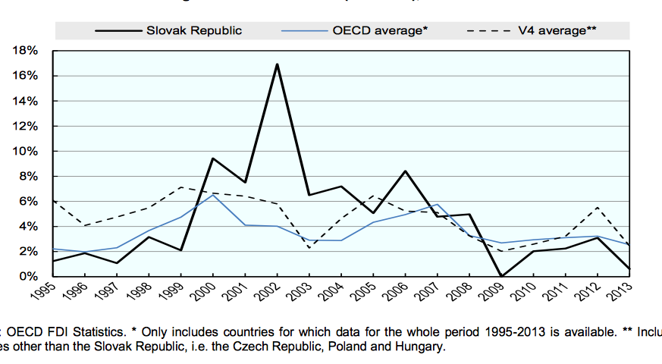
I. PFM Reform at Home Visualization: FDI inflows

Slide 7
II. Fiscal Decentralization
Coupling competences with resources
Transfer of competences according to the subsidiarity principle accompanied by fiscal decentralization
Top-down: fixed ratio for redistribution of PIT revenues is set at 6,2 : 23,5 : 70,3 (state, HTUs and municipalities)
Bottom-up: HTUs and municipalities acquire right to decide about selected local taxes (e.g. tax on vehicles used for commercial purposes in HTUs)
→→ Implications for budgeting: revenues increase and their inflow becomes more stable

Slide 8
II. Fiscal Decentralization
Introducing Program-based Budgeting
Regional and local governments instructed to prepare their own program structures for budgets
Methodological guidance rendered by the MF SR
Program structure: 3 levels, goals/objectives need to be defined per each program component
Performance set to be measured by indicators through a regular monitoring process
→→ PBB rollout: to the regional and local government supported by a separate project and piloted in 30 self-governments of different sizes

Slide 9
II. Fiscal Decentralization
Milestones of the Implementation Process
2001
PBB piloted at central level of government
higher territorial units (HTUs) delineated
2002 – 2004
Budgetary competences transferred to higher territorial units (HTUs) and municipalities
2005
Supreme Audit Office reserves right to exercise control over all public resources
reserve created for municipalities in state budget to mitigate risks associated with transition

Slide 10
CAPACITY BUILDING Performance-oriented management culture Information and communication campaigns Identifying reform champions Addressing mid-level management resistance SUSTAINABILITY
II. Fiscal Decentralization
Key Ingredients
MULTISTAKEHOLDER APPROACH
Dialogue and bottom-up reform strategy
Buy-in on central level of government
Donor support
Leveraging conditionality
COMMITMENT
IMPLEMENTATION
Flexible legislative frameworks
Certified methodological guidelines
Complementary reforms
Completion within a single cycle
GRADUALISM / PHASING
ACCOUNTABILITY
Competence AND resource transfer Transparent resource (re-)allocation system
Auditing
M&E frameworks
TRUST

Slide 11
III. Knowledge Exchange
Lessons learned
GAINS:
independence from central government
fiscal discipline on the part of HTUs and municipalities (balanced budgets, addressing “hidden” debt)
transparency and accountability (vertical and horizontal)
CHALLENGES:
Addressing territorial fragmentation
Stepping up efforts to mainstream performance-oriented budgetary practices via capacity building

Slide 12
III. Knowledge Exchange
Slovakia-UNDP Partnership
Framework: joint project of MF SR and MFEA SR financed via development aid, implemented by UNDP
Content: sharing lessons from Slovakia’s political and economic transformation
Themes: MF SR oversees the “public finance for development” component
Target countries: Moldova and Montenegro, Western Balkans and Eastern Partnership more broadly
→→ Key principles of our engagement with partners: demand-driven, “best-size” fit, sustainable (i.e. programmatic approach)

